Slide 1
Practical guide to using CRISPR tools
Case study 1: Individual CRISPR-knockout
How to scale to CRISPR screens
Case study 2: Base editing
Emerging tools for base editing screen design
Case study 3: Prime editing
The first tool for prime editing screen design

Slide 2
Goal: Create a CRISPR-KO cell line
Considerations:
Editing efficiency
Off-targets
Mutational outcomes
Large deletions/
Chromosome loss
Editor size
Delivery vehicle
PAM requirement
(Cas species)

Slide 3
Goal: Create a CRISPR-KO cell line
Considerations:
Editing efficiency
Off-targets
Mutational outcomes
Editing strategy?
RNA editing
Prime editing
Nuclease cutting
+ HDR template
Base editing
Nuclease cutting
Epigenetic
editing

Slide 4
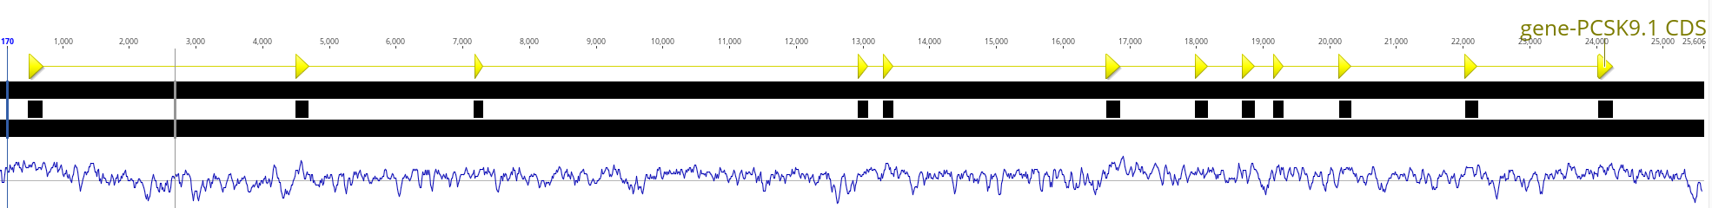
Goal: Create a KO cell line for PCSK9
Generate a cell line with no functional PCSK9 protein to study this gene’s function in the lab
Editing efficiency
Off-targets
Mutational outcomes
strategy:
Nuclease cutting
General position?
Probably not very close to start or end of gene
In constitutive exon
Design an sgRNA
exact position?

Slide 5
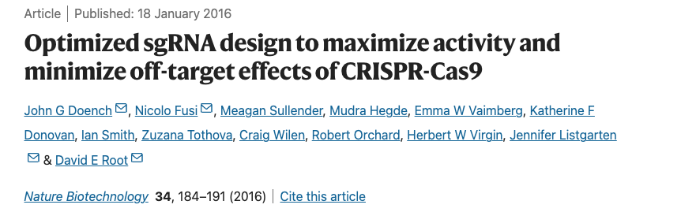
sgRNA design
Editing efficiency
Off-targets
Choice of sgRNA is the major factor that determines editing efficiency
Nucleotide sequence (GC content etc.)
Chromatin context / cell type
There are tools to help design efficient sgRNAs
Ex. Doench 2016 “rule set 2”
Performed large screens of thousands of sgRNAs
Trained a model to predict sgRNA efficiency
Based only on gRNA sequence – no context / cell specific info
Doench et al. Nature Biotech 2016

Slide 6

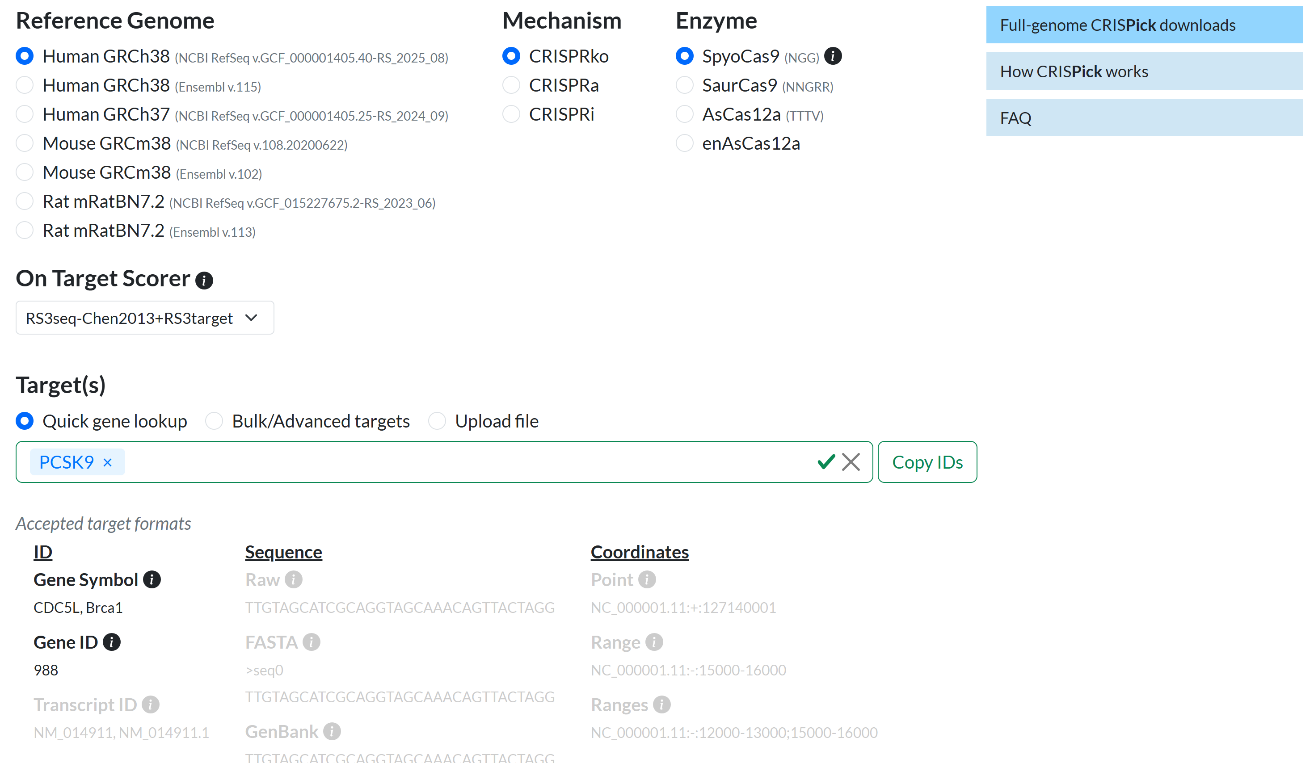
sgRNA design demo
https://portals.broadinstitute.org/gppx/crispick/public

Slide 7
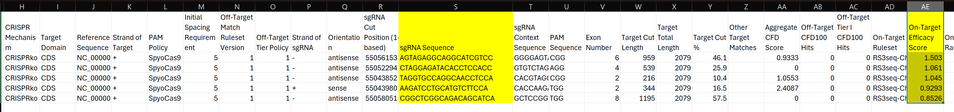
sgRNA design demo
https://portals.broadinstitute.org/gppx/crispick/public
For individual gene KO, testing 1-2 top-scoring gRNAs is plenty
Clone gRNA into appropriate vector to express in target cell line along with Cas9

Slide 8
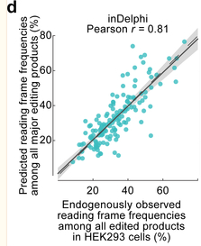
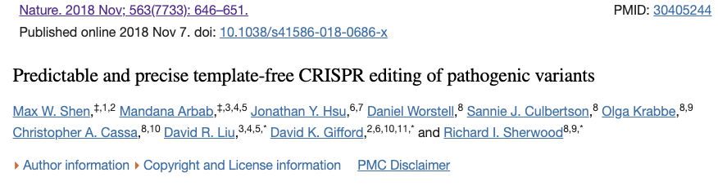
sgRNA design
Precision of
Edit outcome
For knockout we don’t care too much about the exact editing outcome
Most indels will cause loss of function
Want to avoid -3n (in-frame) indels
Indel signatures of different sgRNAs are not random!
Different repair pathways act on target sites to produce different edit outcomes
We can predict the most likely outcomes

Slide 9

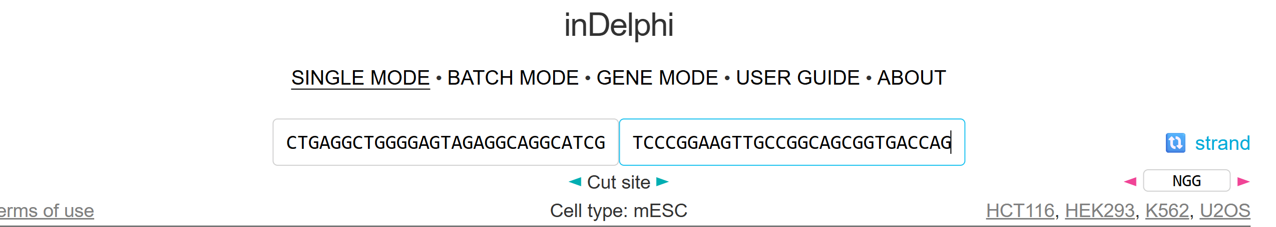
sgRNA design demo
https://indelphi.giffordlab.mit.edu/
Top-scoring PCSK9 gRNA:
CTACCTCGGGAGCTGAGGCTGGGGAGTAGAGGCAGGCATCGTCCCGGAAGTTGCCGGCAGCGGTGACCAG
Spacer
PAM
Cutsite is between 3rd and 4th nt of spacer with respect to PAM
Plug in the sequences to the left and right of the cutsite

Slide 10
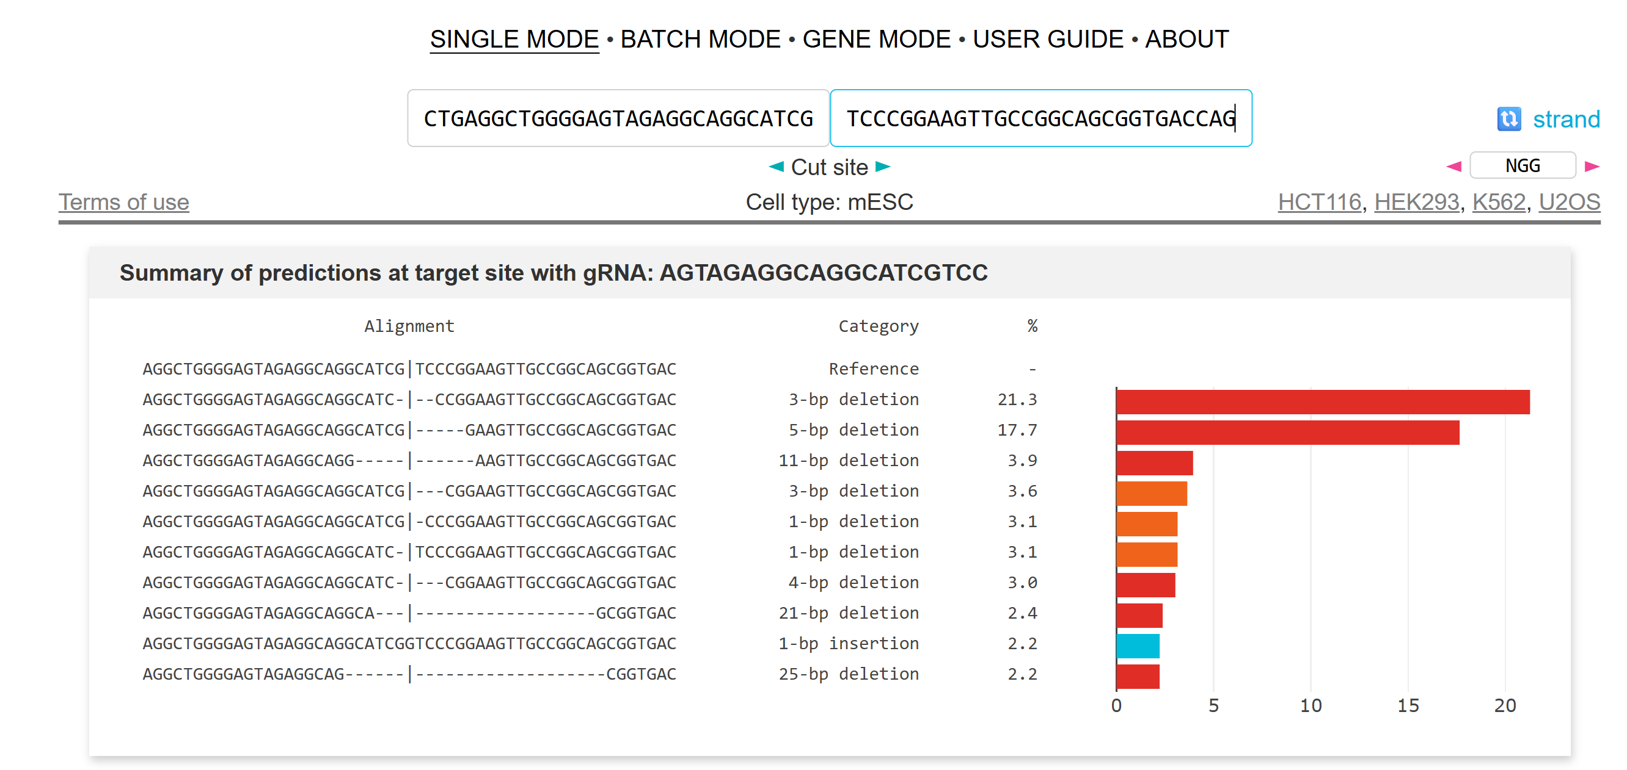
sgRNA design demo
https://indelphi.giffordlab.mit.edu/

Slide 11
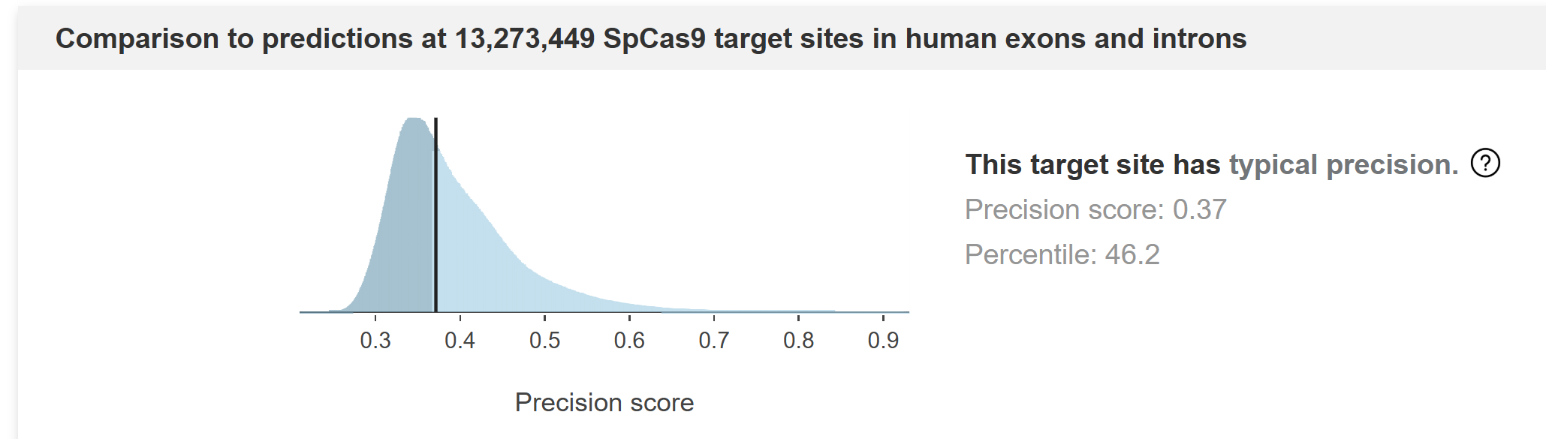
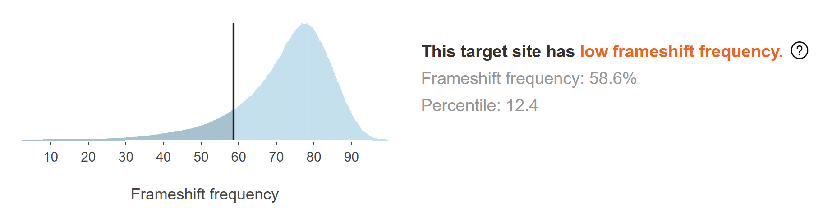
sgRNA design demo
Conclusion:
It is probably safest to choose a different PCSK9-targeting gRNA with higher predicted frameshift frequency

Slide 12
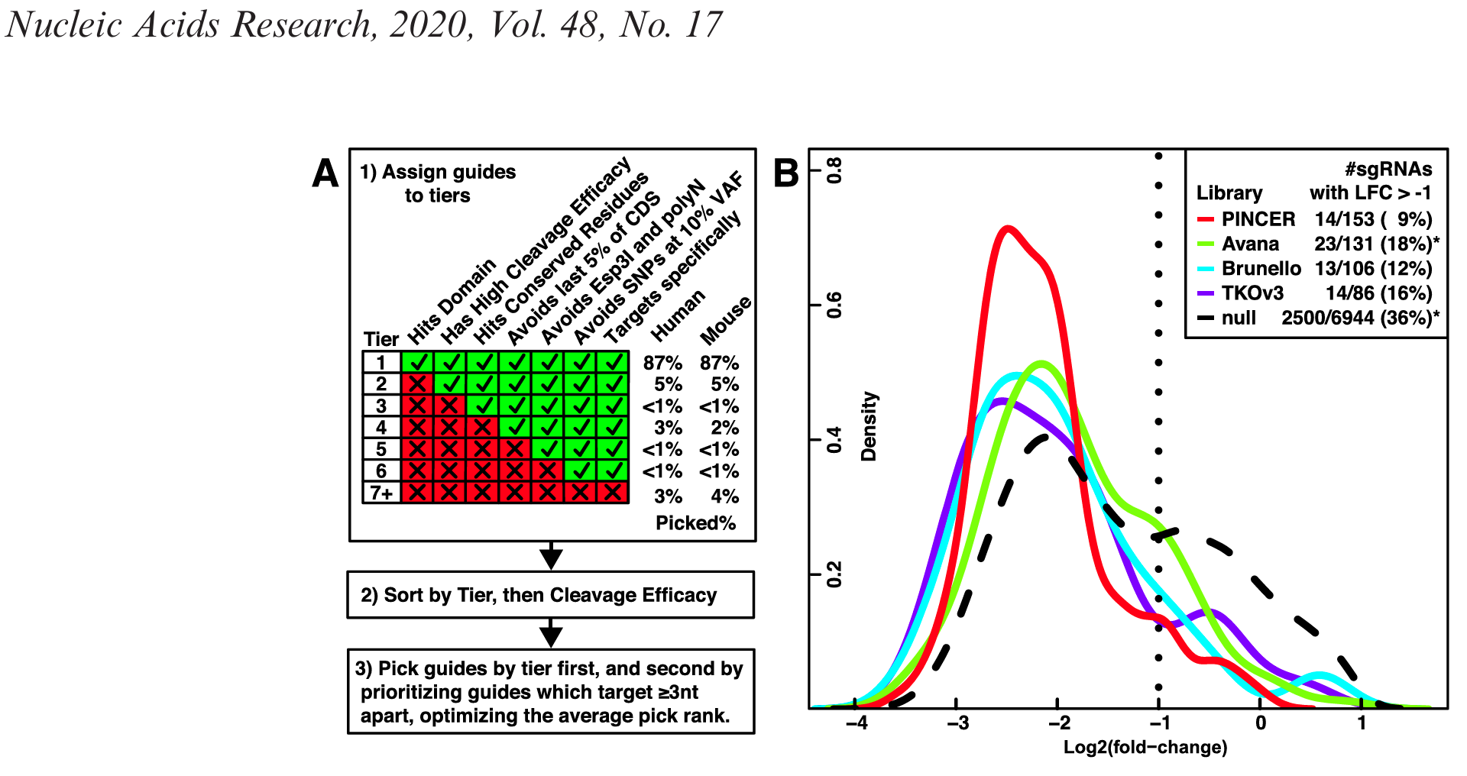
Scaling up to genome-wide CRISPR-knockout screening
Luckily, there have been many efforts to incorporate best practices in the design of genome-wide CRISPR-KO libraries
Probably best to draw from one of these:
PINCER (see citation below)
MinLibCas9 from https://doi.org/10.1186/s13059-021-02268-4

Slide 13
Case study 2: Base editing
Single-nucleotide variants comprise the majority of pathogenic human mutations
Rees et al 2018 Nat Rev Genet

Slide 14
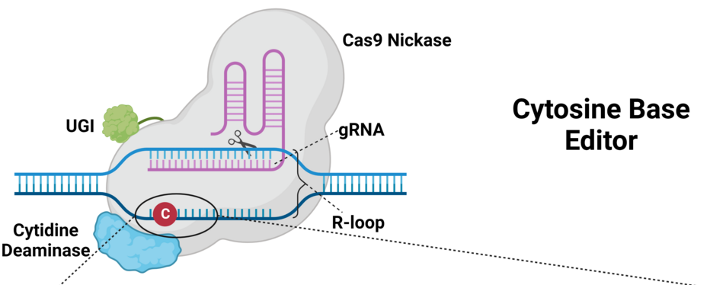
Base editors harness cytosine deaminases
4 components of a cytosine base editor (CBE)
gRNA localizes Cas9^{D10A} nickase to target site, leading to R-loop formation
Komor et al 2016, Nature, Crisprmedicinenews.com
Notes:
The cytosine base editor has 4 key components for its function. The first is the sgRNA, necessary both for localization, but also for R-loop formation.
What makes BE specific is the fact that….R-loop

Slide 15
Base editors harness cytosine deaminases
4 components of a cytosine base editor (CBE)
gRNA localizes Cas9^{D10A} nickase to target site, leading to R-loop formation
APOBEC/AID family cytosine deaminase catalyzes C→U deamination on opposing strand
Komor et al 2016, Nature, Crisprmedicinenews.com
Notes:
Then the APOBEC….
But then you’re left with a mismatch… resolved in favor of… to bias…

Slide 16
Base editors harness cytosine deaminases
4 components of a cytosine base editor (CBE)
gRNA localizes Cas9^{D10A} nickase to target site, leading to R-loop formation
APOBEC/AID family cytosine deaminase catalyzes C→U deamination on opposing strand
Cas9^{D10A} nickase cuts the gRNA-bound strand to stimulate DNA repair
Komor et al 2016, Nature, Crisprmedicinenews.com

Slide 17
Base editors harness cytosine deaminases
4 components of a cytosine base editor (CBE)
gRNA localizes Cas9^{D10A} nickase to target site, leading to R-loop formation
APOBEC/AID family cytosine deaminase catalyzes C→U deamination on opposing strand
Cas9^{D10A} nickase cuts the gRNA-bound strand to stimulate DNA repair
UGI (bacterial UDG inhibitor) prevents excision of cytosine by UNG, a natural part of base excision repair of deoxy-uracils
Komor et al 2016, Nature, Crisprmedicinenews.com

Slide 18
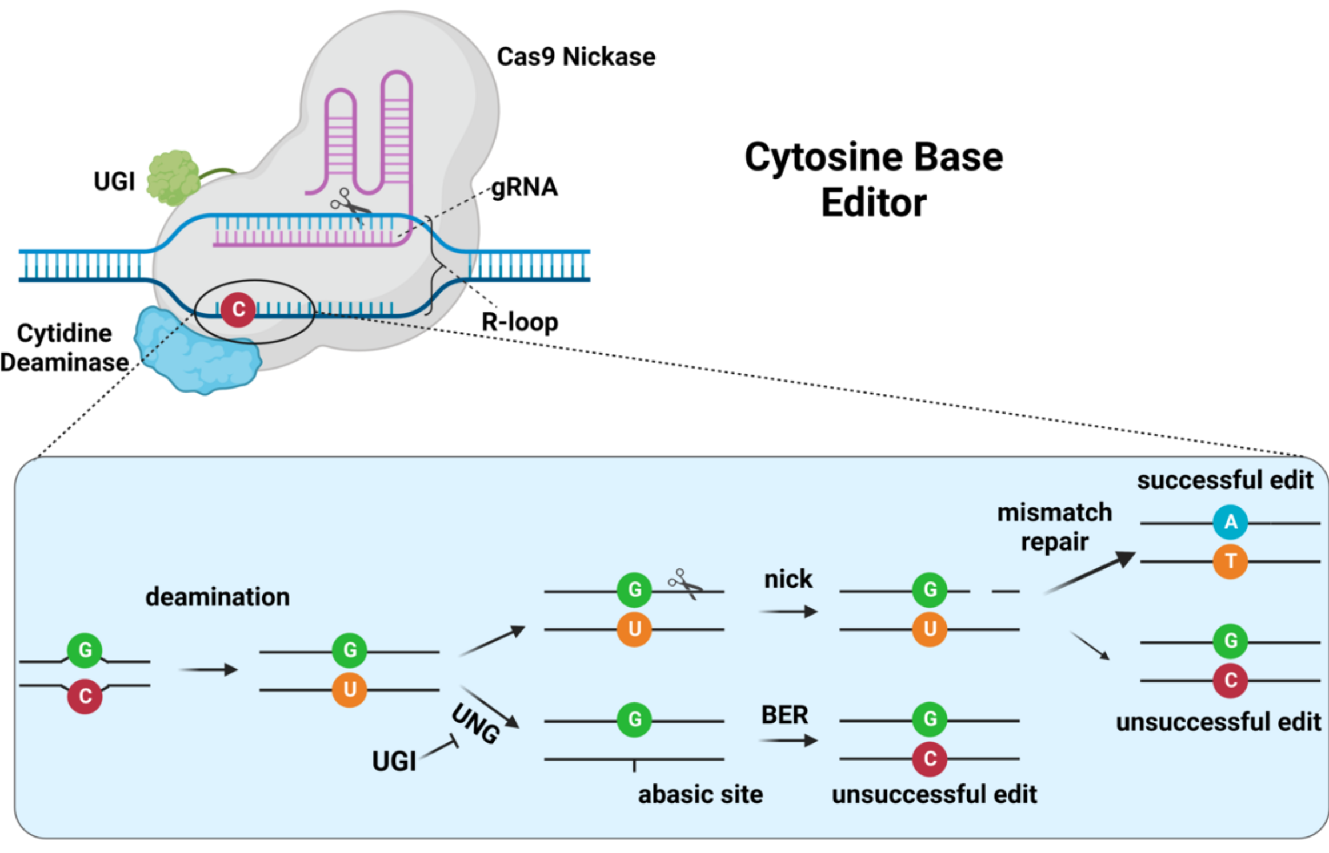
Cytosine base editing mechanism
Crisprmedicinenews.com

Slide 19
Cytosine base editing can only model and correct a subset of single-nucleotide variants
Modeled by CBE
Corrected by CBE
Landrum et al 2016 Nuc Acids Res
Notes:
If we look at pathogenic human variation and
break down the SNPs that underlie these diseases, we see that
CBEs have the potential to restore ~ 14% of these.
Of course, unsurprisingly, due to the hundreds of cytosine deaminations that occur every day in our cells
- the majority of disease causing SNPs are actually also caused by a C:G>T:A change, and could be correctable by making the opposite edit of A:T>GC

Slide 20
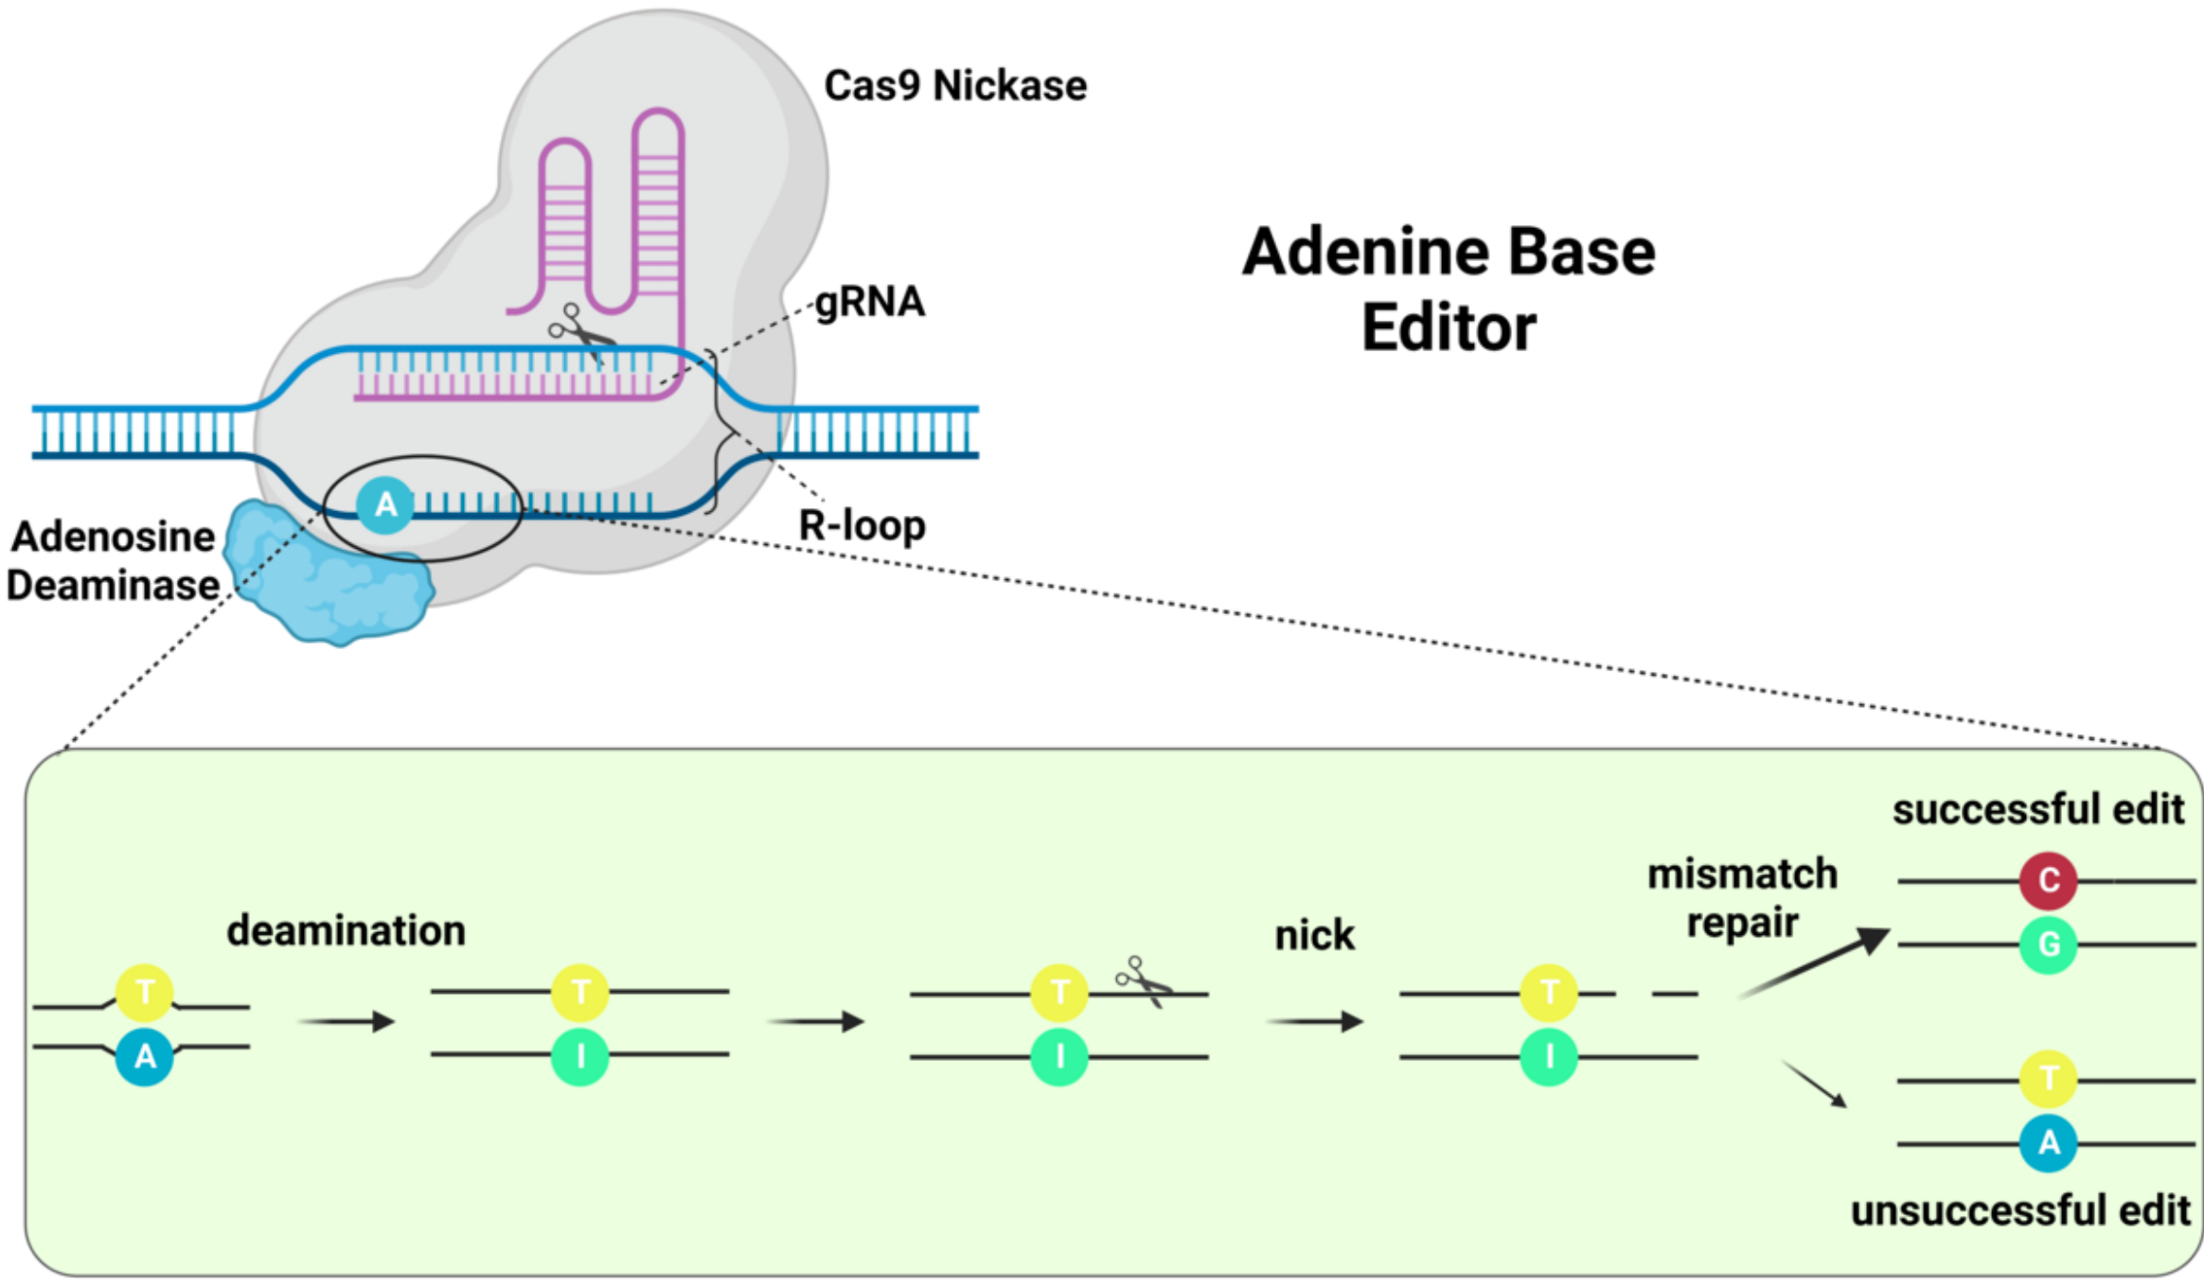
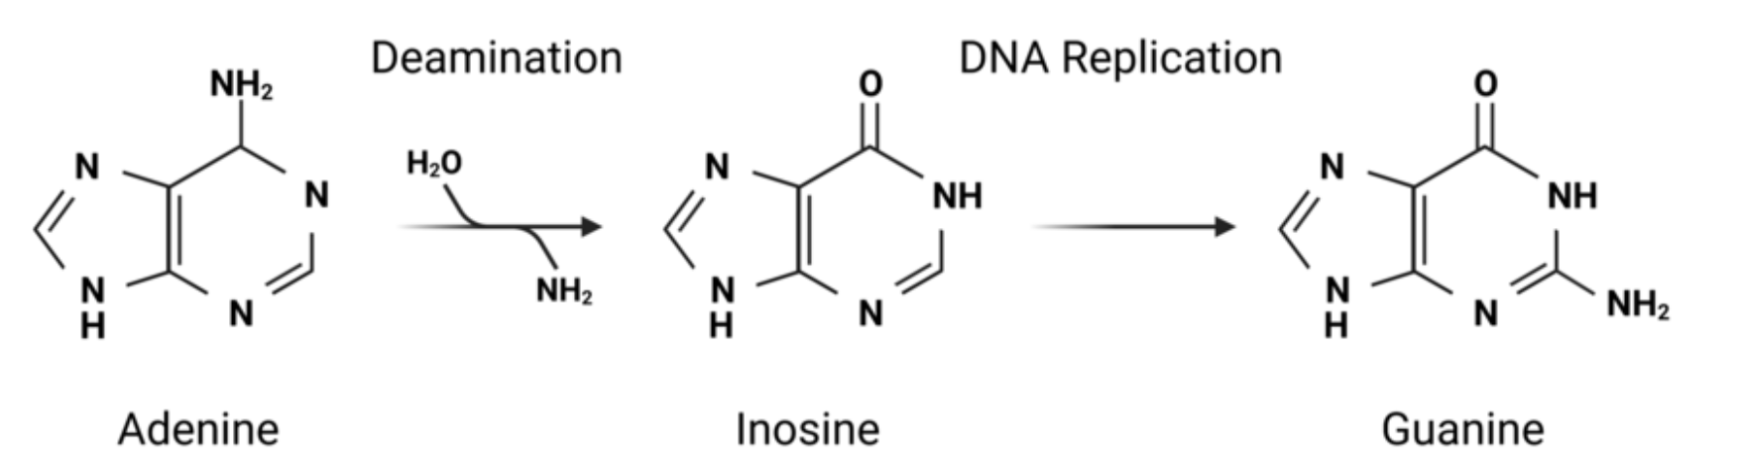
Adenine base editing mechanism
Similar principles as CBEs
No UGI equivalent required because DNA A→I deamination is less common in cells, no dedicated inosine repair pathway to inhibit
Crisprmedicinenews.com

Slide 21
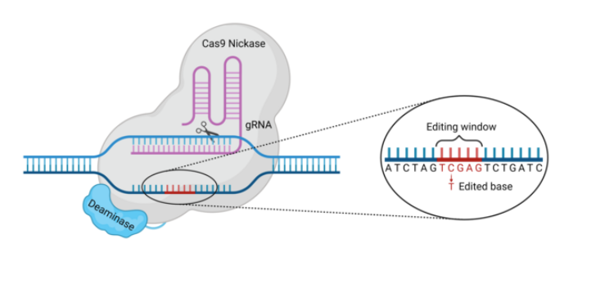
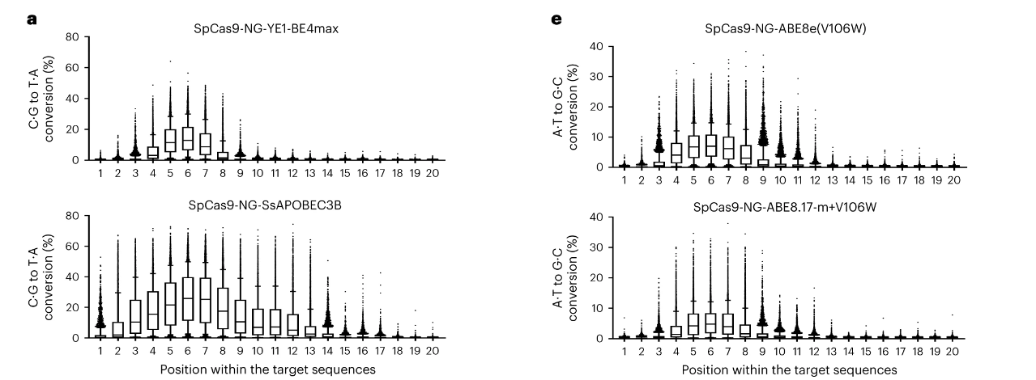
Base editing occurs within a window
Editing window defined by:
Single-stranded DNA (R-loop)
Positioning of deaminase relative to Cas9 (can be changed by linkers and circular permutant Cas9)
Nahye Kim et al Nat Biotech. 2023
Arbab*, Shen*, et al 2020, Cell, Crisprmedicinenews.com

Slide 22
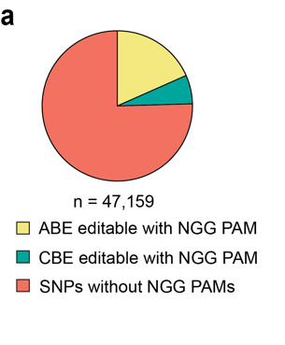
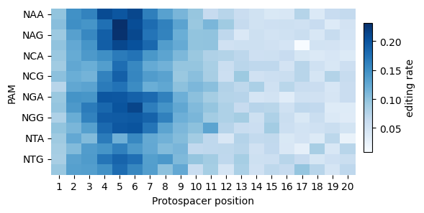
PAM-relaxed Cas variants are useful for BE screening
SpRY is a relaxed PAM variant of SpCas9 (Walton et al 2020 Science)
While it still shows PAM restrictions when used as a nuclease, its base editing activity is relatively uniform
This is useful because narrow base editing window makes editing of a specific target variant challenging with PAM-restricted Cas species
Ryu et al 2024 Nature Genetics

Slide 23
Base editing gRNA design considerations
Efficiency of gRNA at binding and nicking
CRISPick is still a good resource to exclude inefficient gRNAs
2. Efficiency of editing a given nucleotide (window, enzyme motif bias)
BE-Hive is the best resource

Slide 24
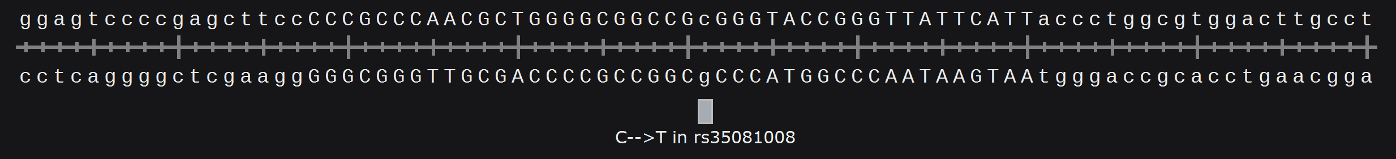
https://www.crisprbehive.design/
Arbab*, Shen* et al 2020 Cell
BE-Hive
rs35081008 is a SNP associated with LDL levels. We want to edit it to test whether this changes cellular LDL uptake
Variant position
P3
P4
P5
P6
P7
P8
P9
CCGCCCAACGCTGGGGCGGCCGcGGGTACCGGGTTATTCATTaccctggcg
CCCGCCCAACGCTGGGGCGGCCGcGGGTACCGGGTTATTCATTaccctggc
cCCCGCCCAACGCTGGGGCGGCCGcGGGTACCGGGTTATTCATTaccctgg
ccCCCGCCCAACGCTGGGGCGGCCGcGGGTACCGGGTTATTCATTaccctg
tccCCCGCCCAACGCTGGGGCGGCCGcGGGTACCGGGTTATTCATTaccct
ttccCCCGCCCAACGCTGGGGCGGCCGcGGGTACCGGGTTATTCATTaccc
cttccCCCGCCCAACGCTGGGGCGGCCGcGGGTACCGGGTTATTCATTacc
Notes:
As mentioned, BE window, other nucleotides, over a dozen deaminases for really just these two flavors of edits, but each enzyme differs in preference motif and window so need to test empirically.
We designed BE-Hive using high throughput base editing data for over two dozen editors to predict outcomes and help to assess precision.
- So ultimately…

Slide 25
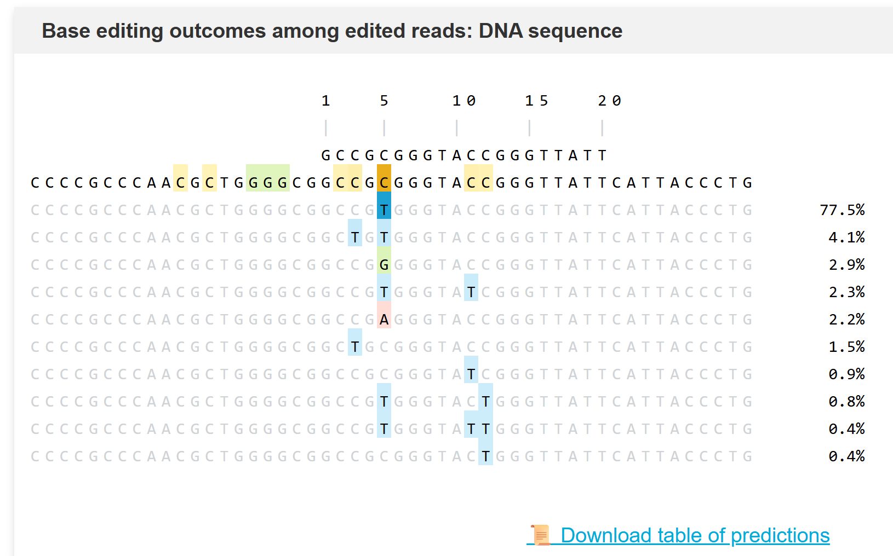
https://www.crisprbehive.design/
Arbab*, Shen* et al 2020 Cell
BE-Hive
rs35081008 is a SNP associated with LDL levels. We want to edit it to test whether this changes cellular LDL uptake
Using BE4 in mES cells, the gRNA that positions rs35081008 in P5 is predicted to produce most efficient and specific editing

Slide 26
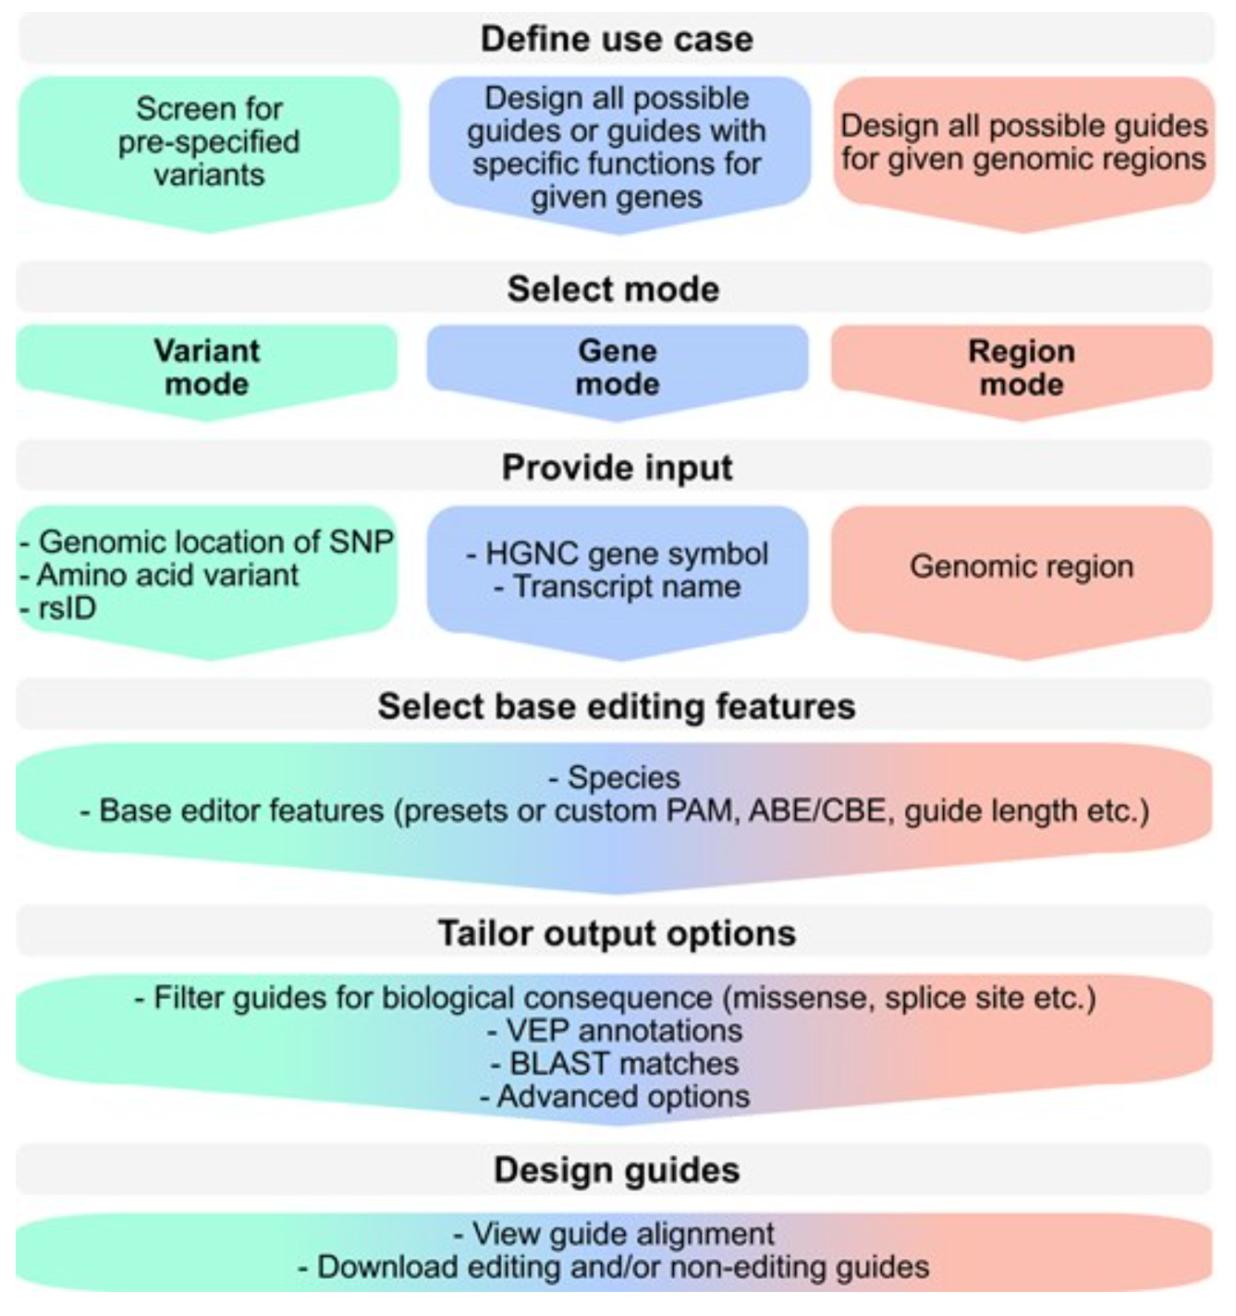
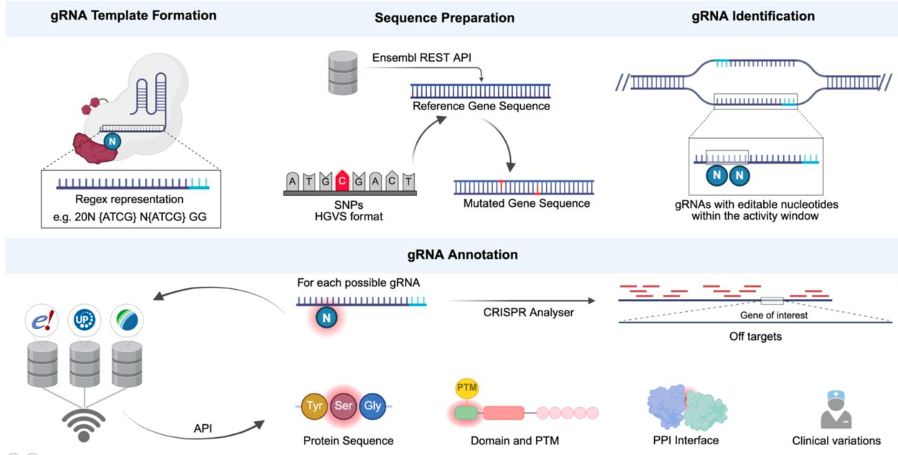
Base editing library design
BEscreen (Schneider et al 2025, NAR)
BEstimate (Dincer et al 2025, biorxiv)
Our lab has not tested these tools

Slide 27
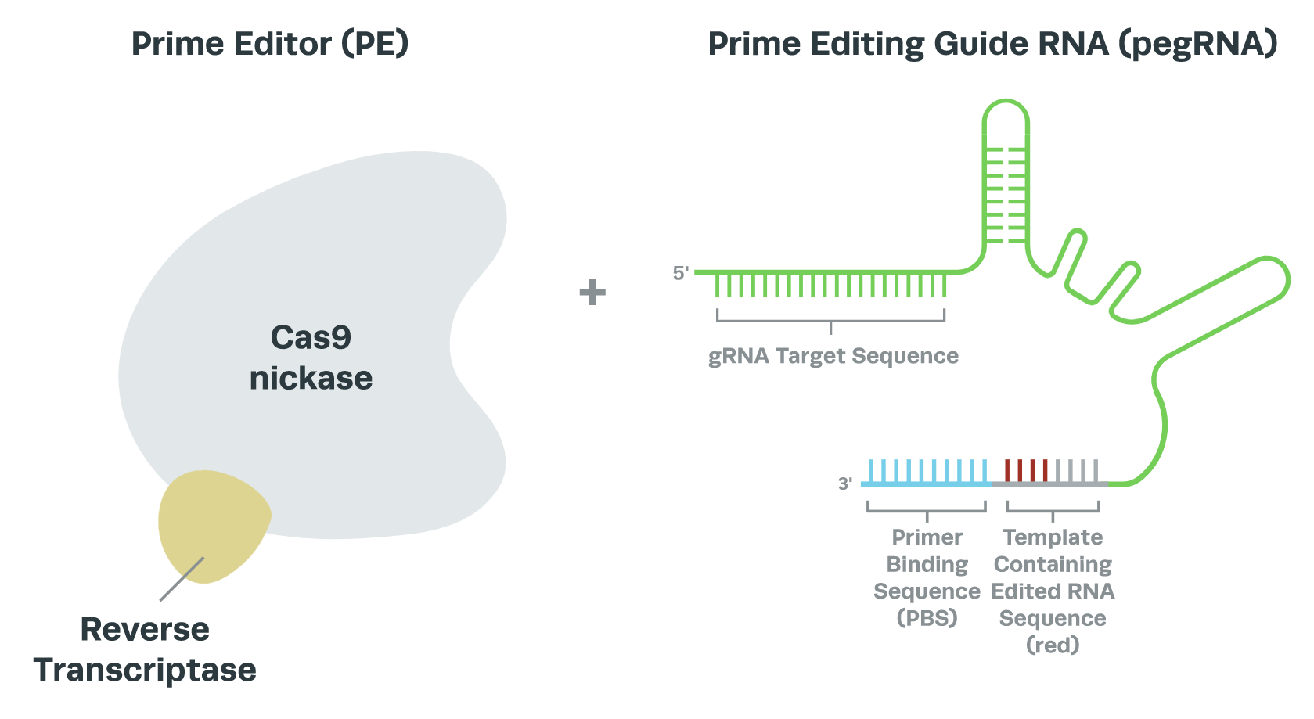
Prime editing: search and replace gene editing
Prime editing harnesses reverse transcriptase to write sequences into genome
Prime editor: Cas9^{H840A} nickase fused to reverse transcriptase (RT)
Prime guide RNA (pegRNA): gRNA fused to RT primer and template to be integrated into genome
Anzalone et al 2020, Nature, Synthego.com

Slide 28
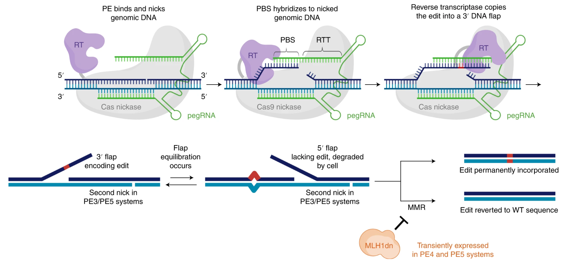
Steps in prime editing
Doman et al 2022, Nat Protocols

Slide 29
Prime editing using standard “PE2” system
Kim et al 2020 Nat Biotech
Prime editing can make all possible substitution, short insertion, and short deletion edits

Slide 30
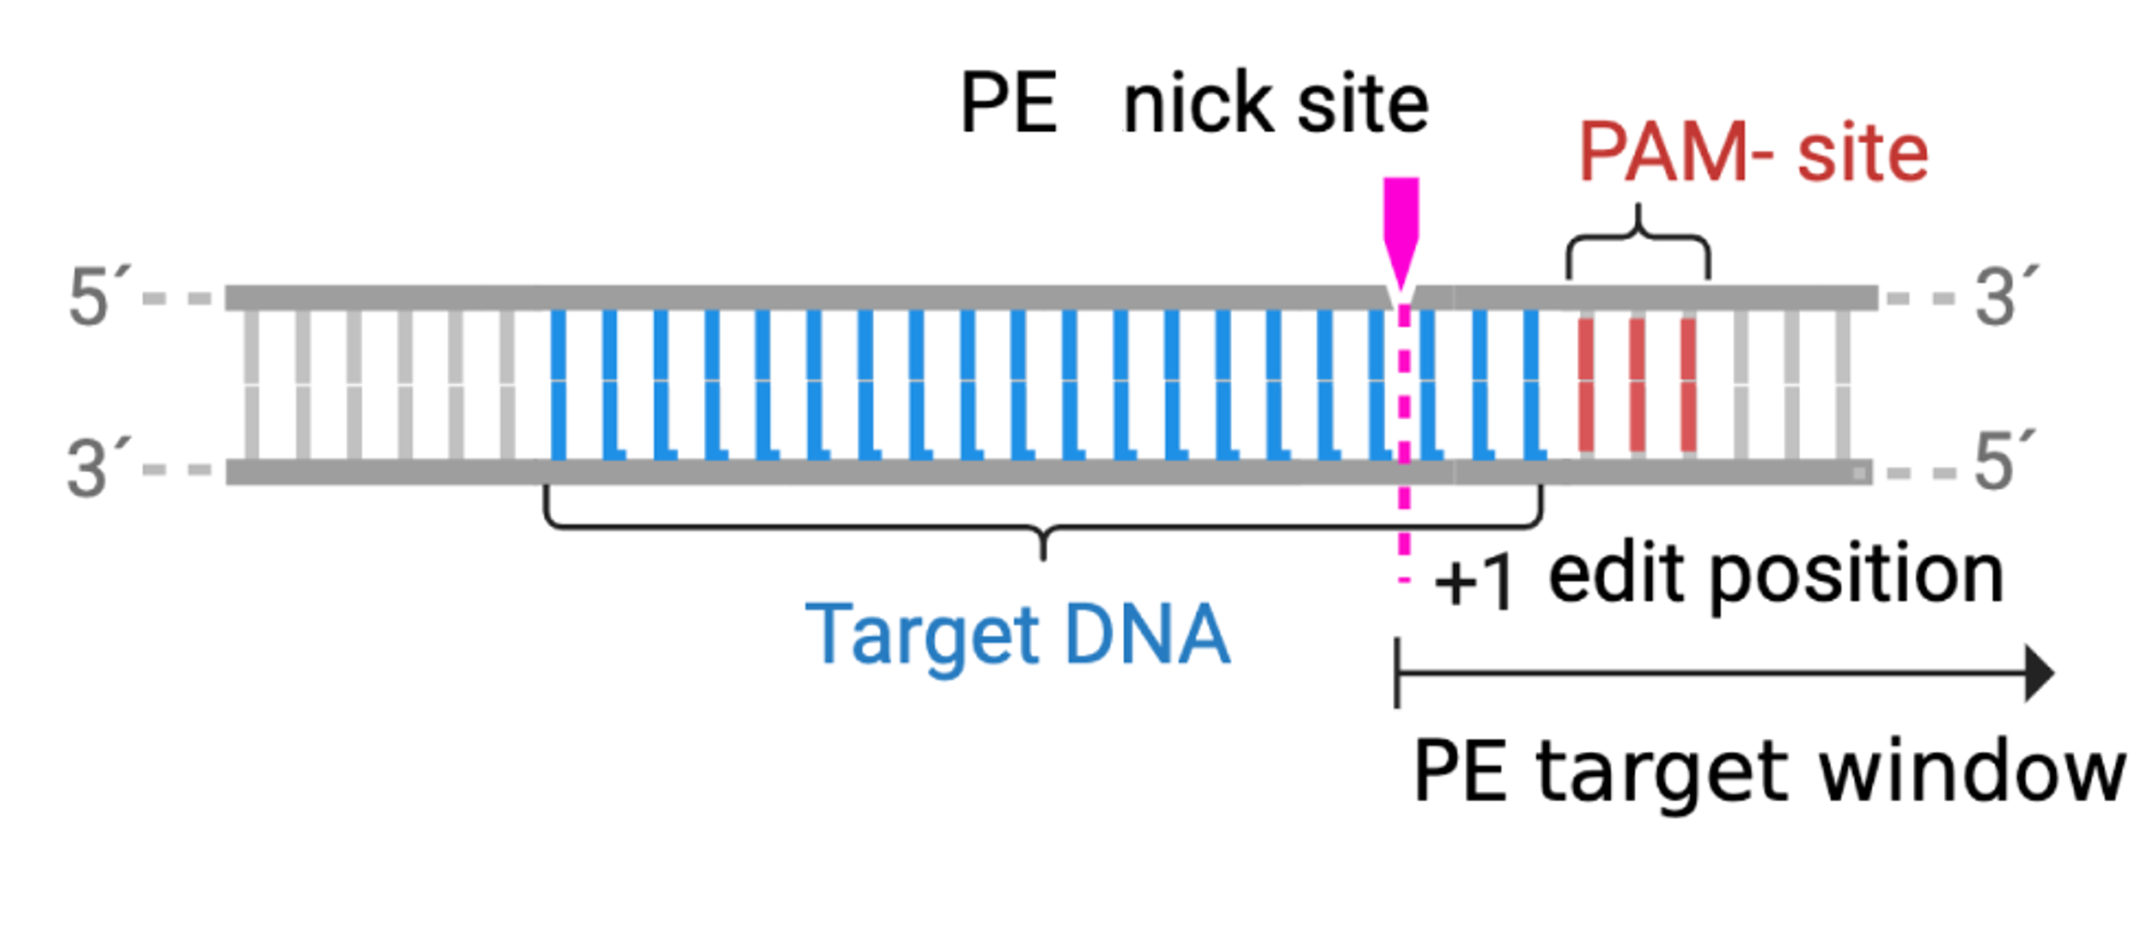
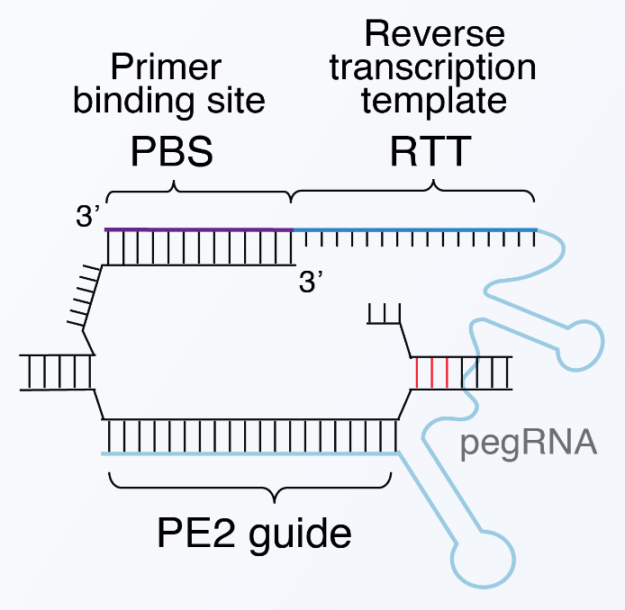
Comparing base and prime editing
Pros of prime editing
PE editing window is extended compared to BE
PE can install a wider variety of edit types
PE has fewer known off-target effects (no mutagenic enzyme)
Cons of prime editing
There are many more permutations of pegRNA design for any given edit than for BE
Prime editors are larger enzymes and pegRNAs are longer RNAs
BE is higher efficiency on average (although prime editing is rapidly improving)

Slide 31
Prime editing is a rapidly evolving field
Improvements to prime editing have included:
Adding a gRNA that produces a distal nick (PE3, but this is complicated to employ in screens and increases indels)
Inhibiting mismatch repair (PE4/PE5)
Reverse transcriptase species and evolved variants (PE6)
Stabilizing pegRNA by adding a pseudo-knot at the end or fusing the RNA 3’ binding La protein to the prime editor (PE7)
High-throughput screening and machine learning to optimize pegRNA design
Altering pegRNA delivery (e.g. circular RNA)
Increasing intracellular nucleotide concentration
Swapping RT for DNA polymerase with a ssDNA template

Slide 32
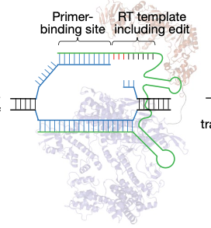
Getting Prime Editors to work in practice
LOTs of variables to choose!
Cas enzyme (like before)
PBS length
RT template length
Guide position (editing at a distance is possible but often less efficient)
Second nick position
pegRNA modifications (epegRNAs)
Silent edits to evade MMR and prevent enzyme re-binding/nicking if PAM is not disrupted

Slide 33
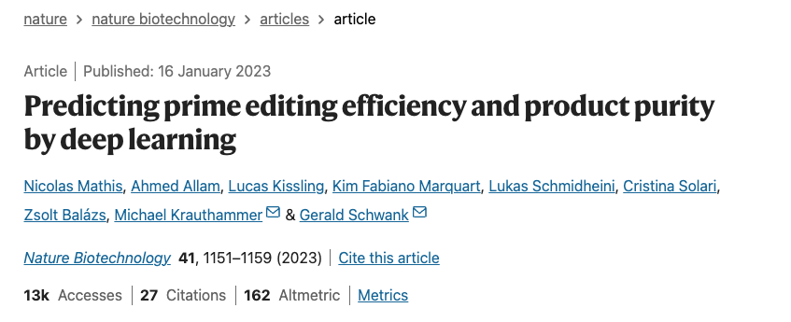
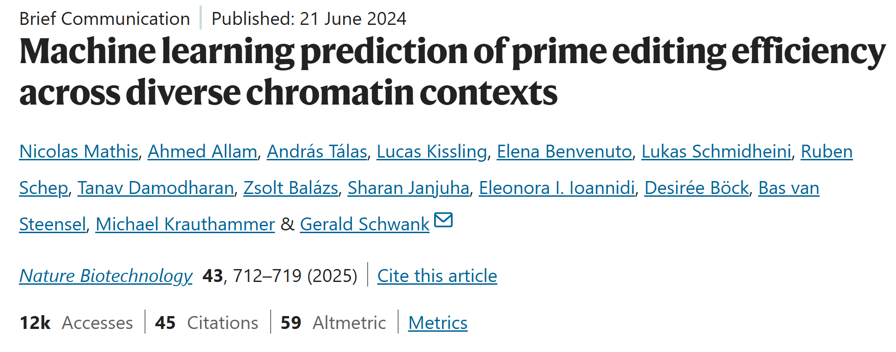
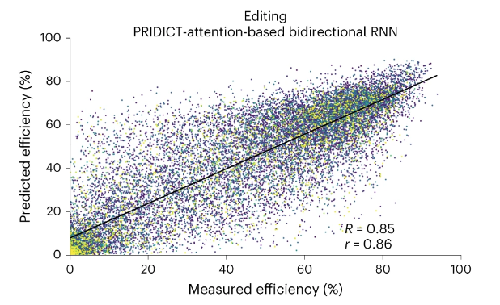
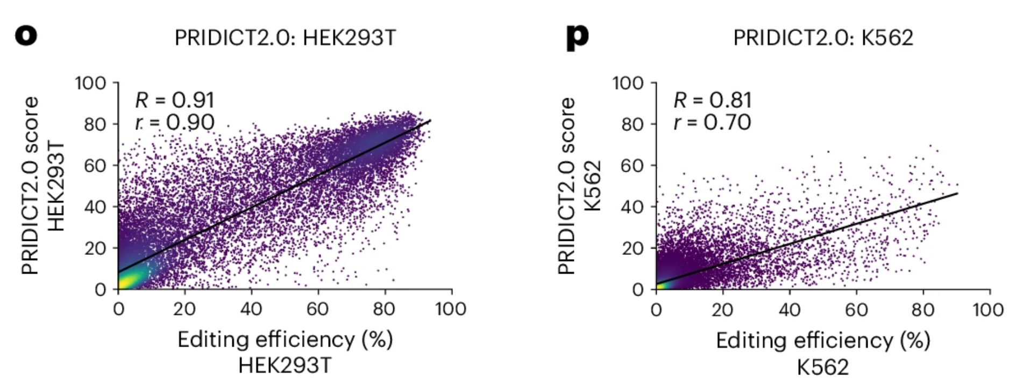
PRIDICT and PRIDICT2.0 use high-throughput screening data to optimize pegRNA design

Slide 34
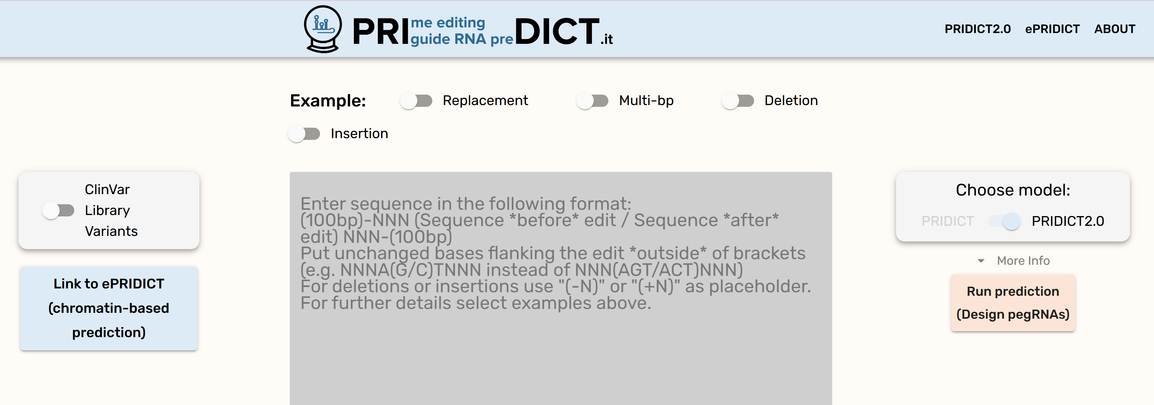
PRIDICT2.0 tutorial
https://www.pridict.it/

Slide 35
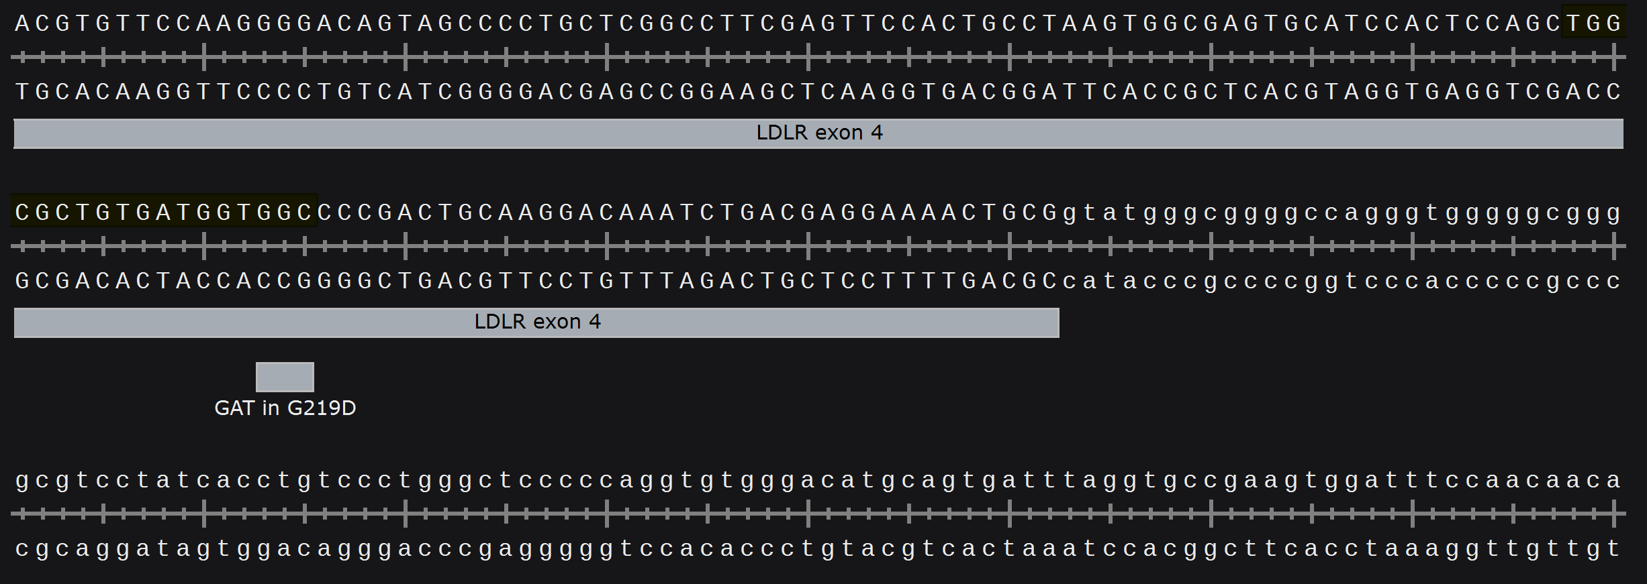
PRIDICT2.0 tutorial
https://www.pridict.it/
Install the LDLR G219D variant which we found to increase LDL uptake using prime editing
PRIDICT2.0 input
GGGTCTTTACGTGTTCCAAGGGGACAGTAGCCCCTGCTCGGCCTTCGAGTTCCACTGCCTAAGTGGCGAGTGCATCCACTCCAGCTGGCGCTGTGATGGTG(GC/AT)CCCGACTGCAAGGACAAATCTGACGAGGAAAACTGCGgtatgggcggggccagggtgggggcggggcgtcctatcacctgtccctgggctcccccaggtg

Slide 36
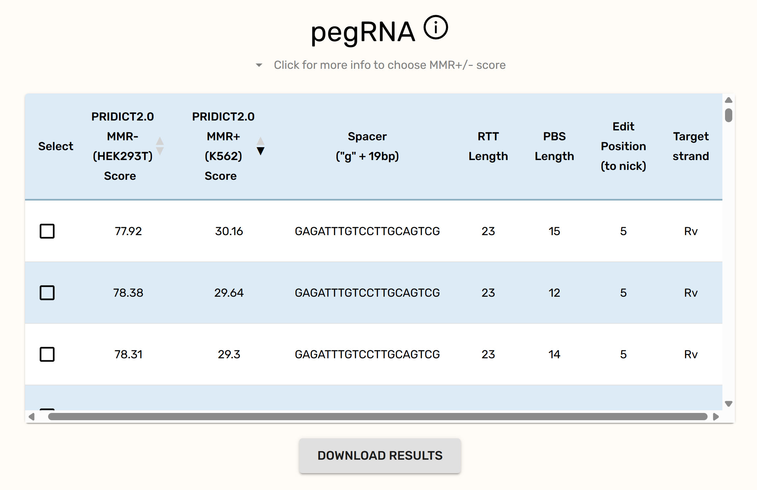
PRIDICT2.0 tutorial
https://www.pridict.it/
PRIDICT2.0 output

Slide 37
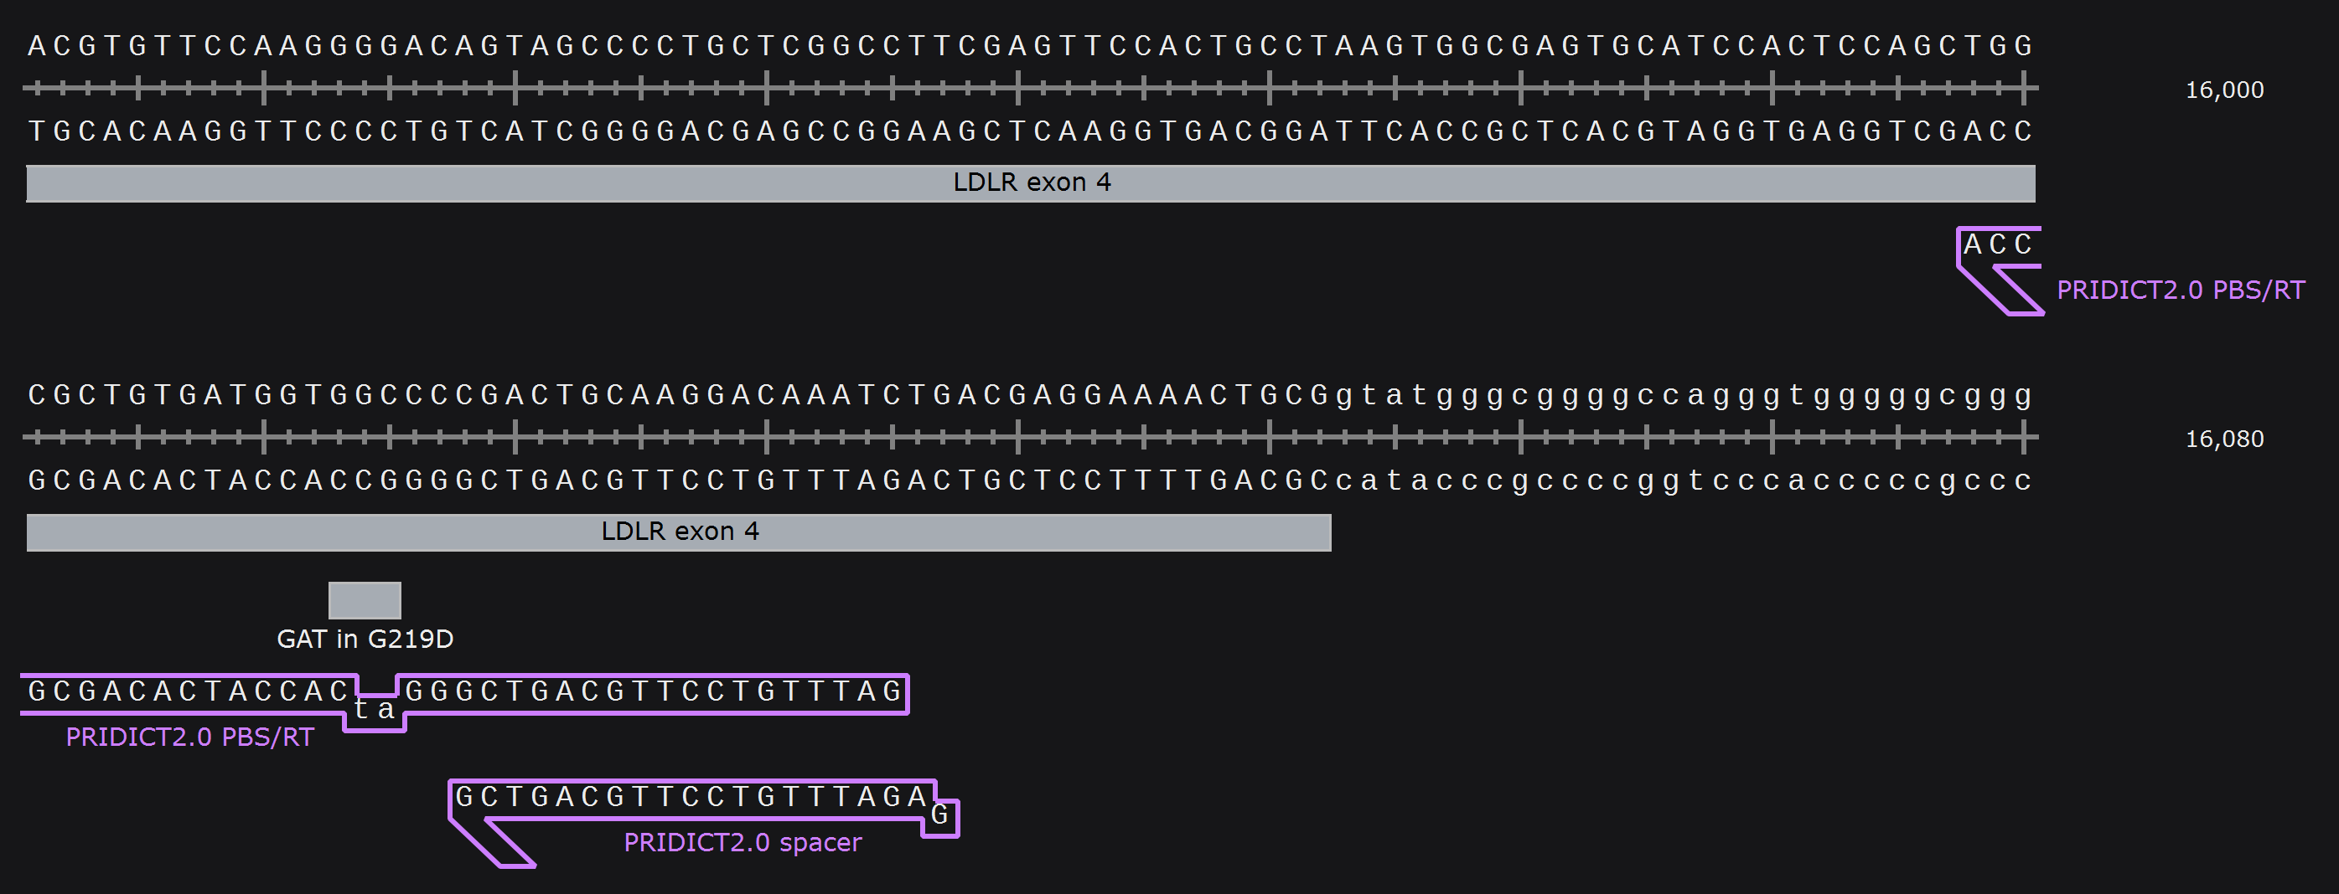
PRIDICT2.0 tutorial
https://www.pridict.it/
PRIDICT2.0 output represented in Snapgene

Slide 38
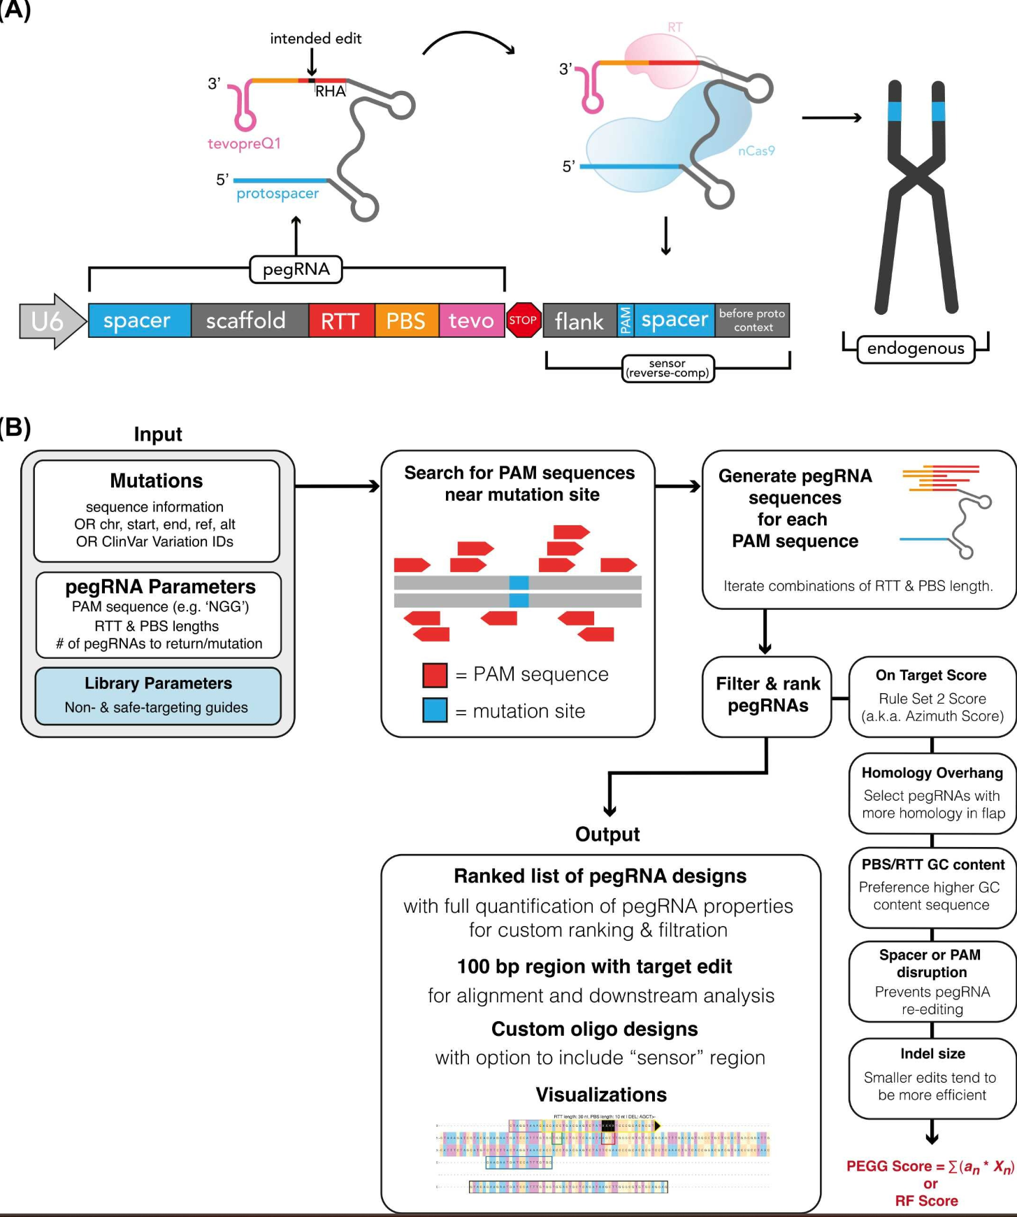
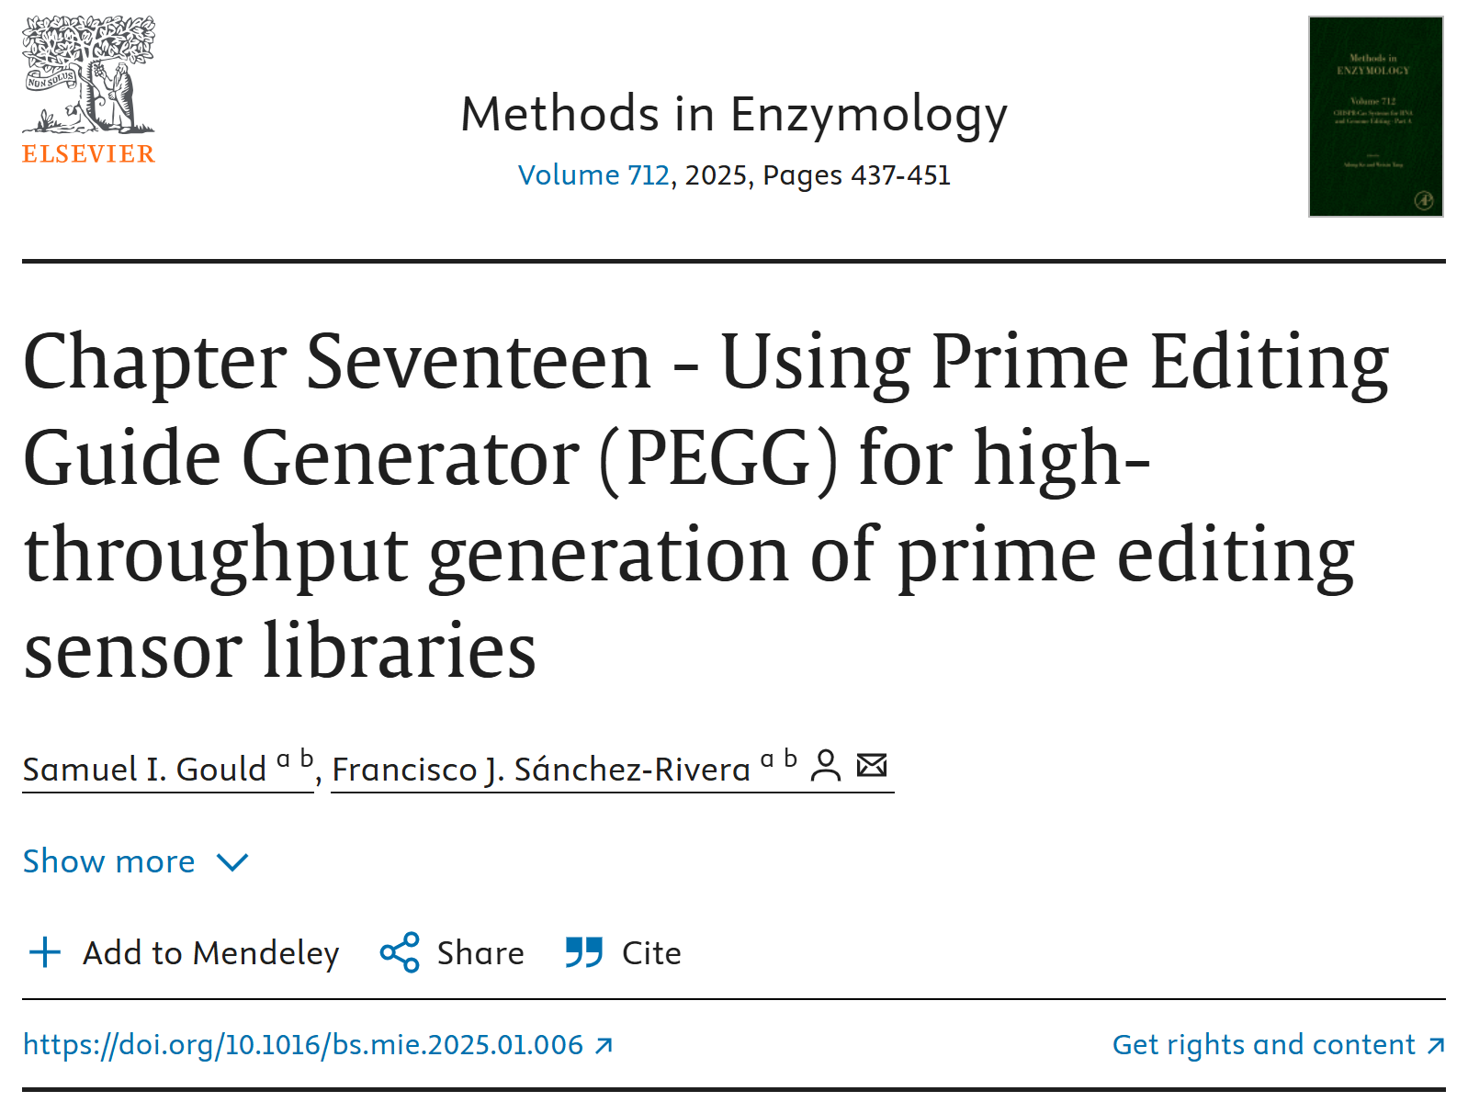
Prime editing library design tool

Slide 39
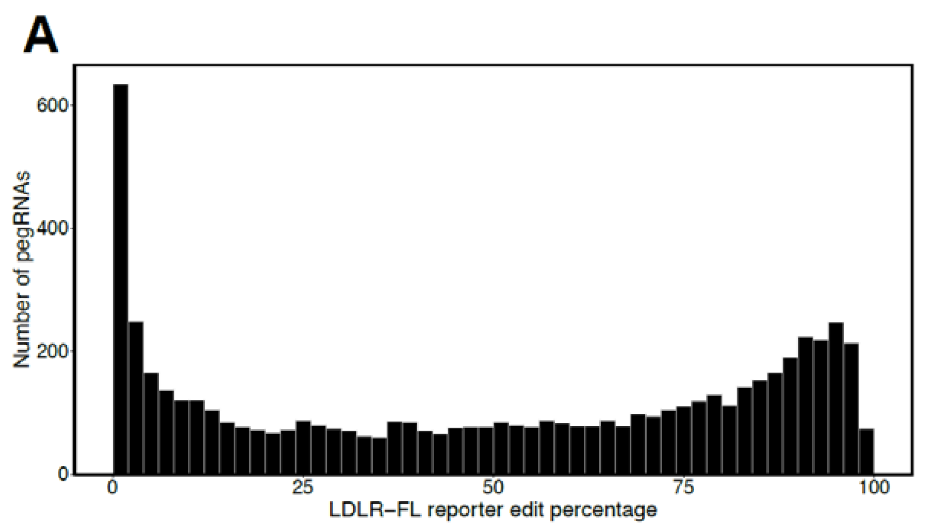
Activity normalization
The problem: gRNAs in CRISPR screens show a wide range of activity
Typical CRISPR screens count gRNAs in phenotypically defined populations, but how do you distinguish a gRNA that edits poorly with one that edits well but causes no phenotype?
Base editing
Prime editing
Ryu et al 2024 Nat Genet
Zhou et al 2025 biorxiv

Slide 40
Activity normalization
Activity normalization accounts for gRNA activity and genotypic outcomes in assigning effect sizes
It is an important tool in accurately interpreting screens for CRISPR approaches with variable efficiency
Ryu et al 2024 Nat Genet

Slide 41
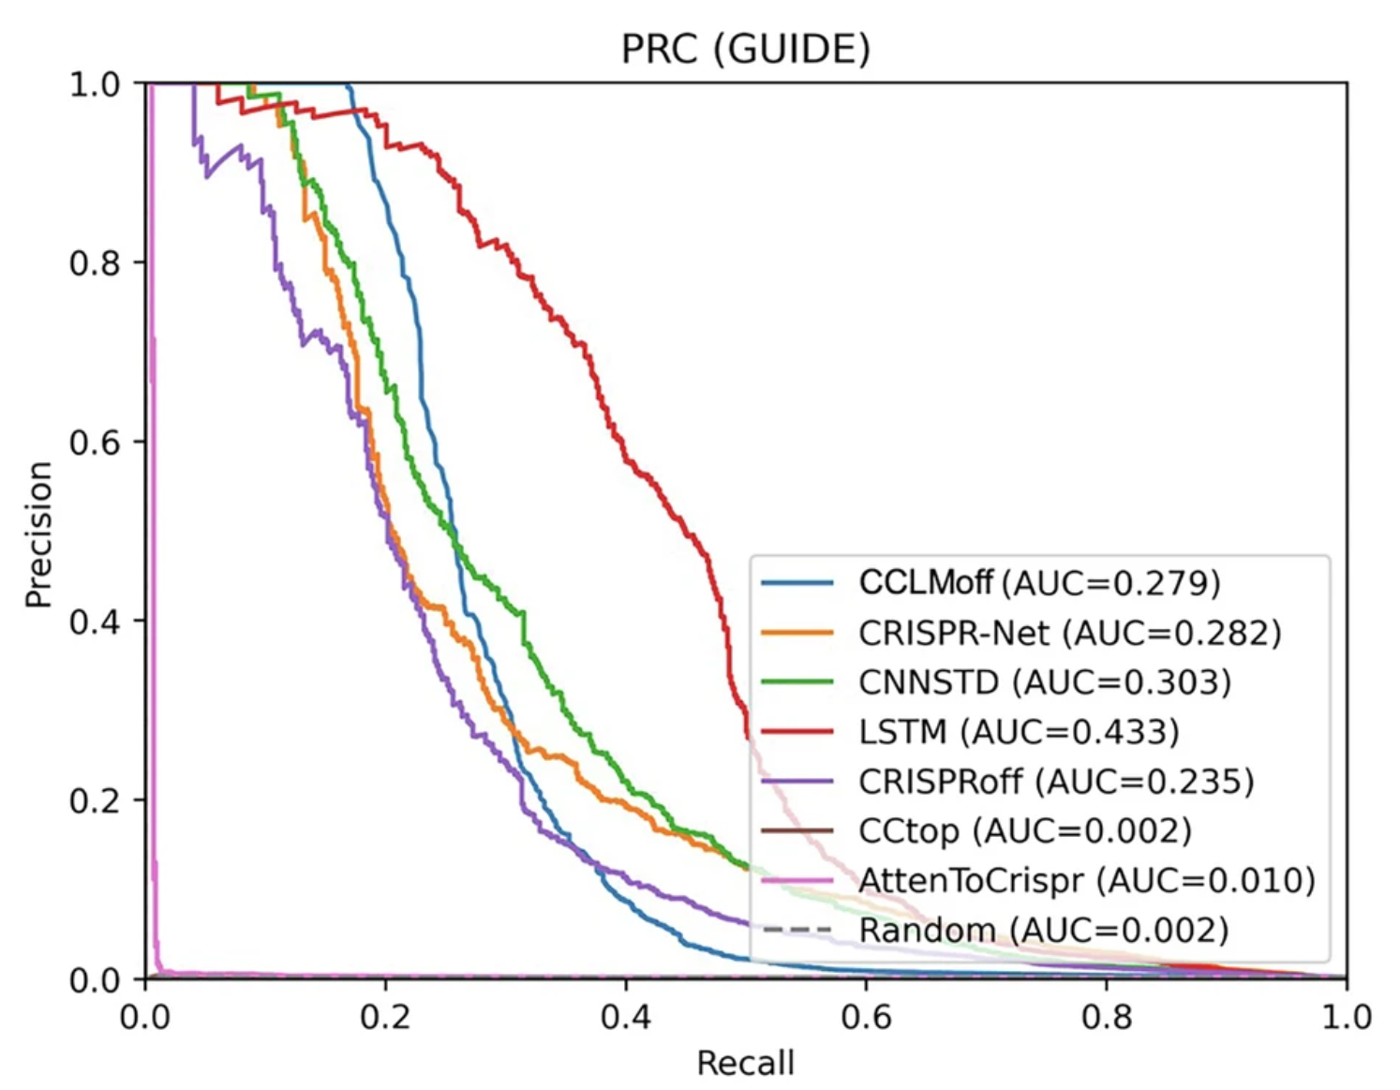
A major omission: off-target prediction
Off-target prediction tools show low recall (they miss the majority of off-targets)
They are useful to eliminate gRNAs with low specificity, which is how CRISPick uses off-target prediction
Accurate off-target prediction is best done using experimental approaches
Base editing off-targets include non-spacer-dependent effects of deaminase editing of ssDNA and RNA
Prime editing has the fewest off-targets because of the multiple homology-dependent events required for successful editing
Off-targets are often ignored in screens due to the difficulty in predicting them
The best safeguard is to utilize several gRNAs with distinct sequences but with the same intended effect (e.g. multiple gRNAs to KO the same gene, multiple gRNAs to install the same base edit)
“Alternative on-target” events are also worth considering (e.g. bystander base edits, long deletions in Cas9-nuclease, indels in prime editing)
Du et al 2025 Commun Biol

